Slide 1
Conformance constraints discovery:
measuring trust in data-driven systems
Notes:
To measure when we should trust predictions made by ML models that learned from data, we propose a new data profiling primitive called Conformance Constraints.

Slide 2
To trust or not to trust?
Notes:
Today’s world is shifting towards data-driven prediction. But we need to be cautious regarding when we should trust predictions made by a machine learned model and when not. This becomes an extremely critical issue when high-stake decisions are taken based on these predictions. Wrong predictions made by machine learned models have caused serious issues in the past, such as unsafe medical treatment

Slide 3

To trust or not to trust?
Notes:
and unsafe self-driving, which even caused human death!

Slide 4
Trusting ML predictions
Training data
New data
Red
Pink
Yellow
Orange
Green
Notes:
So let's take a look at a toy example. Suppose that you have trained your favorite machine learning model using these colorful apples to predict their color. Now you deploy your model and your model seems to work pretty well for these new apples. So far it's all good.

Slide 5

Trusting ML predictions
Training data
New data
Red
Pink
Yellow
Orange
Non-conforming
Green
Green
Notes:
But now, you encounter this new thing, a strange watermelon wedge! Now the question is, would you trust your model’s prediction on this?
In data-driven machine learning, we sometimes encounter tuples, for which, the learned model is very much likely to make an incorrect prediction. This usually happens when the tuple is significantly different from what the model has seen during training. $ These are non-conforming tuples, that is, they don’t conform to the training data.

Slide 6
Non-conformance = untrustworthy prediction
Detection
Explanation
Is it
non-conforming?
Why is it
non-conforming?
Conformance constraints
[SIGMOD 2021]
ExTuNe
[SIGMOD 2020 Demo]
Notes:
We argue that a tuple’s non-conformance is one of the key reasons of why prediction made on that tuple is likely to be untrustworthy. So there are two issues here, the first is to detect whether a tuple is non-conforming and the $ second is to explain why a tuple is non-conforming. But in this talk, I will skip the explanation part and will talk only about detection, but I have some extra slides on the explanation framework which is based on the principles of causality.

Slide 7
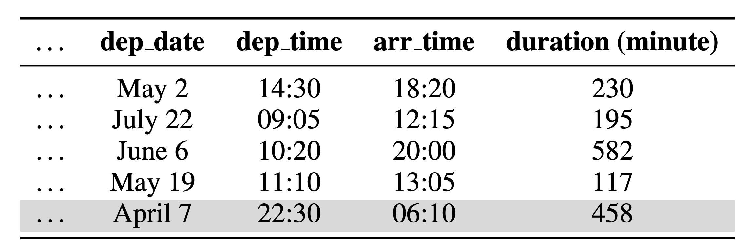
A real-world example: airlines dataset
Regression task: predict arrival delay
DAYTIME
flights
OVERNIGHT flight
Notes:
Let’s take a look at a real-world example. Here you can see a sample of an airlines dataset. In this dataset, there are two types of flights: in daytime flights, arrival time is LATER than the departure time.
And for overnight flights, arrival time can be before than the departure time. The arrival date attribute is absent in this dataset. We trained a linear regression model to predict flight delays on the subset of this dataset with only daytime flights.

Slide 8
A real-world example: airlines dataset
Trained over DAYTIME flights
Constraints
“departure time is earlier than arrival time”
“their difference is very close to flight duration”
OVERNIGHT flights
violate DAYTIME flights’ constraints
incur high regression error
Constraint violation correlates with high regression error
Notes:
When we tested the learned model on other daytime flights, it seemed to perform well. But, for overnight flights, the model drastically failed. We found that there were a bunch of constraints that daytime flights satisfied such as departure time is earlier than arrival time and their difference is very close to flight duration. Overnight flights violated these constraints and for them, the regression error was also much higher. This indicates that constraint violation is strongly correlated with regression error, which results in untrustworthy prediction.

Slide 9
Conformance constraints (CCs)
ML pipelines drop low-variance dimensions to achieve dimensionality reduction.
ML models assume that training data’s constraints/properties will continue to hold during serving.
Notes:
So what type of constraints are best suitable to capture trust in prediction? The key observation here is that ML pipelines often drop low variance dimensions to reduce dimensionality of high-dimensional data. Because, they just assume that these low-variance dimensions will continue to have low-variance in future.

Slide 10
Conformance constraints
constraints that the data satisfies
capture the invariants of the data
Notes:
Conformance constraints are tailored for characterizing trust in ML model predictions. These constraints capture the invariants of the data, which all or most tuples of the training dataset satisfy. Our claim is that tuples that do not conform to the training data, or violates the conformance constraints over the training data, are likely to be subject to untrustworthy prediction.

Slide 11
Conformance constraints
Encode linear arithmetic relationship over multiple attributes.
-𝝐 $≤$(60 . arr_hour + arr_min) – (60 . dep_hour + dep_min) – duration $≤$𝝐
Projection
Lower bound
Upper bound
Notes:
So how does conformance constraints look like? They encode linear arithmetic relationship over multiple numerical attributes. In other words, we take data’s projection onto certain space and put bounds around that projected attribute to construct conformance constraints.

Slide 12
Conformance constraints: example
Height | Weight | BMI
6 feet | 142 lbs | 19.3
5 feet | 170 lbs | 33.2
5 feet | 130 lbs | 25.4
10 ≤ BMI ≤ 40
-40 ≤ (28 X Height— Weight) ≤ 30
Notes:
As an example, consider a simple health dataset with three attributes, height, weight, and BMI.
A simple constraint on this dataset is that “BMI should be between 10 and 40”. For this, the projection is onto the BMI dimension.
A slightly more complex constraint is that “28 times height minus weight should be within the range -40 and 30”. Here, the projection is on a linear combination of height and weight.

Slide 13
Violation of conformance constraint
10 ≤ BMI ≤ 40
10 ≤ BMI ≤ 40
Height | Weight | BMI
6 feet | 142 lbs | 19.3
5 feet | 170 lbs | 33.2
5 feet | 130 lbs | 25.4
6 feet | 170 lbs | 231
Notes:
Now suppose that a new tuple arrives with BMI 231. This tuple is clearly non-conforming since it violates the conformance constraint that states the typical range of BMI.

Slide 14
Degree of violation
10 ≤ BMI ≤ 40
10 ≤ BMI ≤ 40
Height | Weight | BMI
6 feet | 142 lbs | 19.3
5 feet | 170 lbs | 33.2
5 feet | 130 lbs | 25.4
6 feet | 170 lbs | 231
6 feet | 170 lbs | 20000
Notes:
Now another tuple arrives with BMI 20,000. This tuple is way more non-conforming than the previous tuple.
To capture the degree of non-conformance, we measure how much it violates the conformance constraints. More violation means more non-conformance, which implies less trust to the predictions made on them.

Slide 15
Projection
-𝝐 $≤$(60 . arr_hour + arr_min) – (60 . dep_hour + dep_min) – duration $≤$𝝐
Projection
Lower bound
Upper bound
Notes:
The key component of a conformance constraint is projection, which tells us through which lens to look at the data. Once we have decided on a projection, we can easily construct the bounds from the data’s distribution on that specific projection.

Slide 16


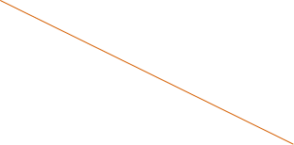
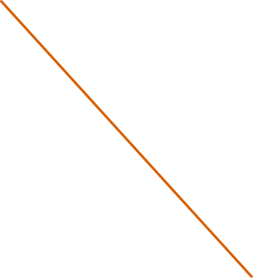
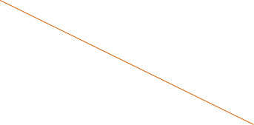
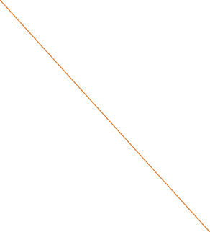
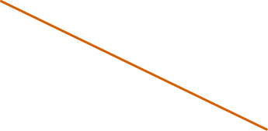
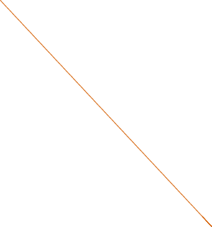
Low-variance projections
High variance
F2
Low variance
F3
F1
High variance
Notes:
But what are the principles to define good projections? As we show in the paper, there are two things: first is, look for low-variance projections.
For example, here the projection F3 has lower variance than the other two projections, and as you can see, it captures the trend in the data better, and results in a narrower bound than the other two projections.

Slide 17
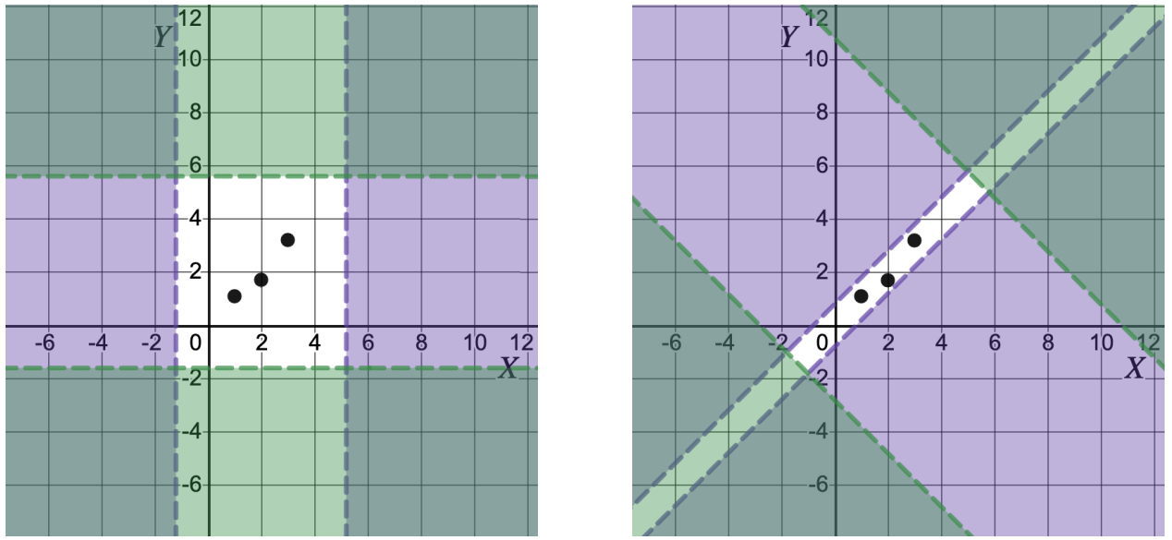


Projections with small mutual correlation
Notes:
The second principle is about selecting a group of projections. Here you can see the attributes X and Y are correlated in the data. Therefore, on the left, correlated projections X and Y result into conformance constraints forming a large conformance zone, which is the clear area, and it is not as effective as the one on the right, where two uncorrelated projections X − Y and X + Y give us conformance constraints forming a smaller conformance zone, which is just this narrow area.

Slide 18
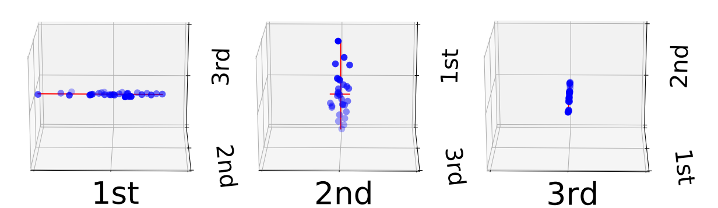
Discovering projections: Principal Component Analysis (PCA)
Small mutual correlations
Why? PCA generates orthogonal projections
Low-variance
Weigh low variance more
Weigh high variance less
weight
Notes:
Our two principles for finding best set of projections perfectly align with the classical method of principal component analysis, or PCA in short. PCA produces projections with small mutual correlations. The intuition is that the principal components that PCA returns are orthogonal to each other.
But traditionally, people have used PCA for dimensionality reduction, so they keep the components that explain most of the variance in the data. But interestingly, a by product of PCA are the low-variance components, which are kind of constant terms. Our key idea is the we can use these as constraints over the data. So the lower the variance of a projection, the stronger the constraint for that projection.
To prioritize low-variance projections more, while computing violation of CCs, we put more weight on violations of low-variance CCs and less weight on violations with respect to high variance CCs.

Slide 19
Experimental results: two applications
Trusted Machine Learning
Data-drift
Is there a relationship between CC violation and the ML model’s prediction accuracy?
Can CCs be used to quantify data drift?
Notes:
Now I want to show you some interesting results of conformance constraints in two application areas. The first one is trusted machine learning, where we investigate if there is a relationship between conformance constraint violation and the ML model’s prediction accuracy. The second application is data drift: given two datasets, can violation of conformance constraints quantify how much one dataset drifts from the other?

Slide 20
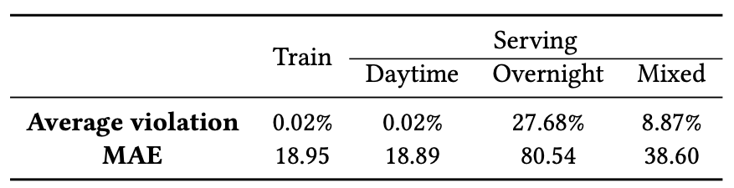
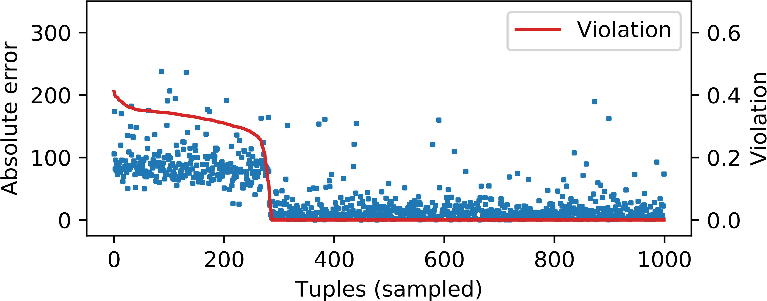
Trusted machine learning: airlines dataset
Notes:
Here is the result on the airlines example I showed before. We indeed observed that violation of conformance constraints, which is shown by the red solid line here, has strong correlation with regression error, which shown by the blue dots.

Slide 21
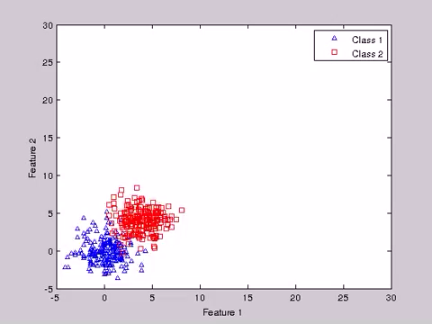
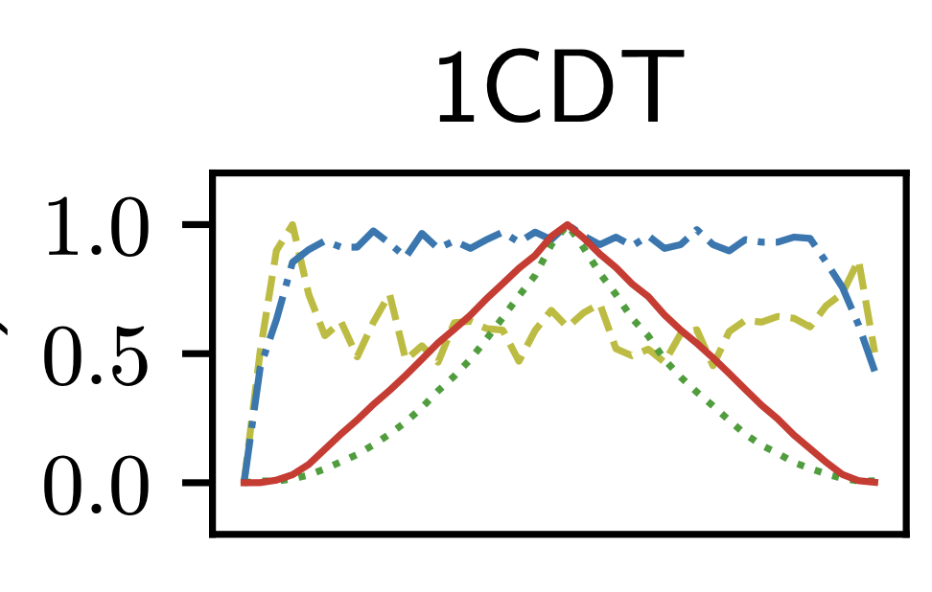
Data drift: EVL benchmark (1/3)
Notes:
Now here is an interesting experiment on data drift quantification. On the left, you can see how the data drifts over time. As time advances the data keeps drifting apart, and then again comes back to the original distribution. On the right, we show plots of CC violation and 3 other baselines that quantify data drift. As you can see, CCs captured this drift very accurately, steadily increasing and then steadily decreasing. In contrast the other approaches model lots of noise.

Slide 22
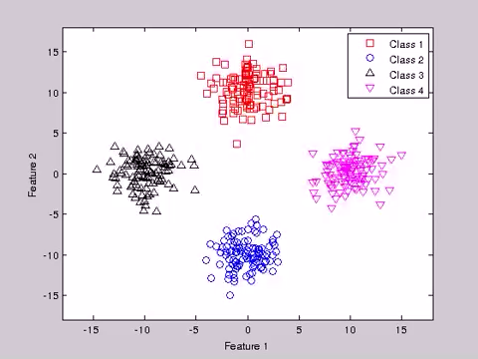
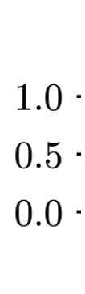
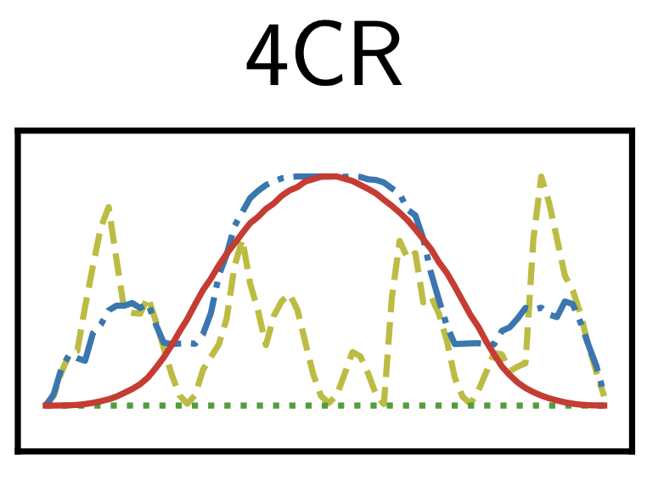
Data drift: EVL benchmark (2/3)
Notes:
Let’s see another example. In this case, the drift is mostly local, that is, if you ignore the colors and shapes, the data isn’t drifting much. So data drift detection approaches that only model global change fail to capture such drift, which is the case for this green flat line here. But CCs capture this drift nicely and it shows gradual increase and then gradual decrease of drift quantity.

Slide 23
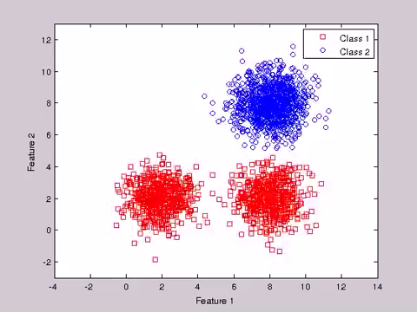
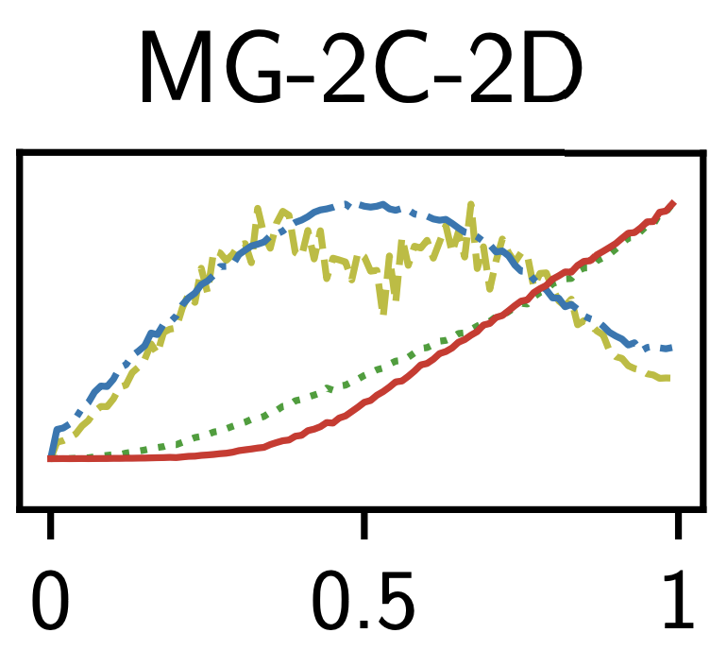
Data drift: EVL benchmark (3/3)
Notes:
Here is a last example. In this case, the data drifts away from the initial distribution and never comes back, as you can tell. And now look at the right: CCs capture this drift accurately as well.

Slide 24

Conformance constraints for data cleaning

Slide 25
